Slide 1
Man-in-the-Middle (MITM) Attack (ARP Spoofing) and Mitigation

Slide 2
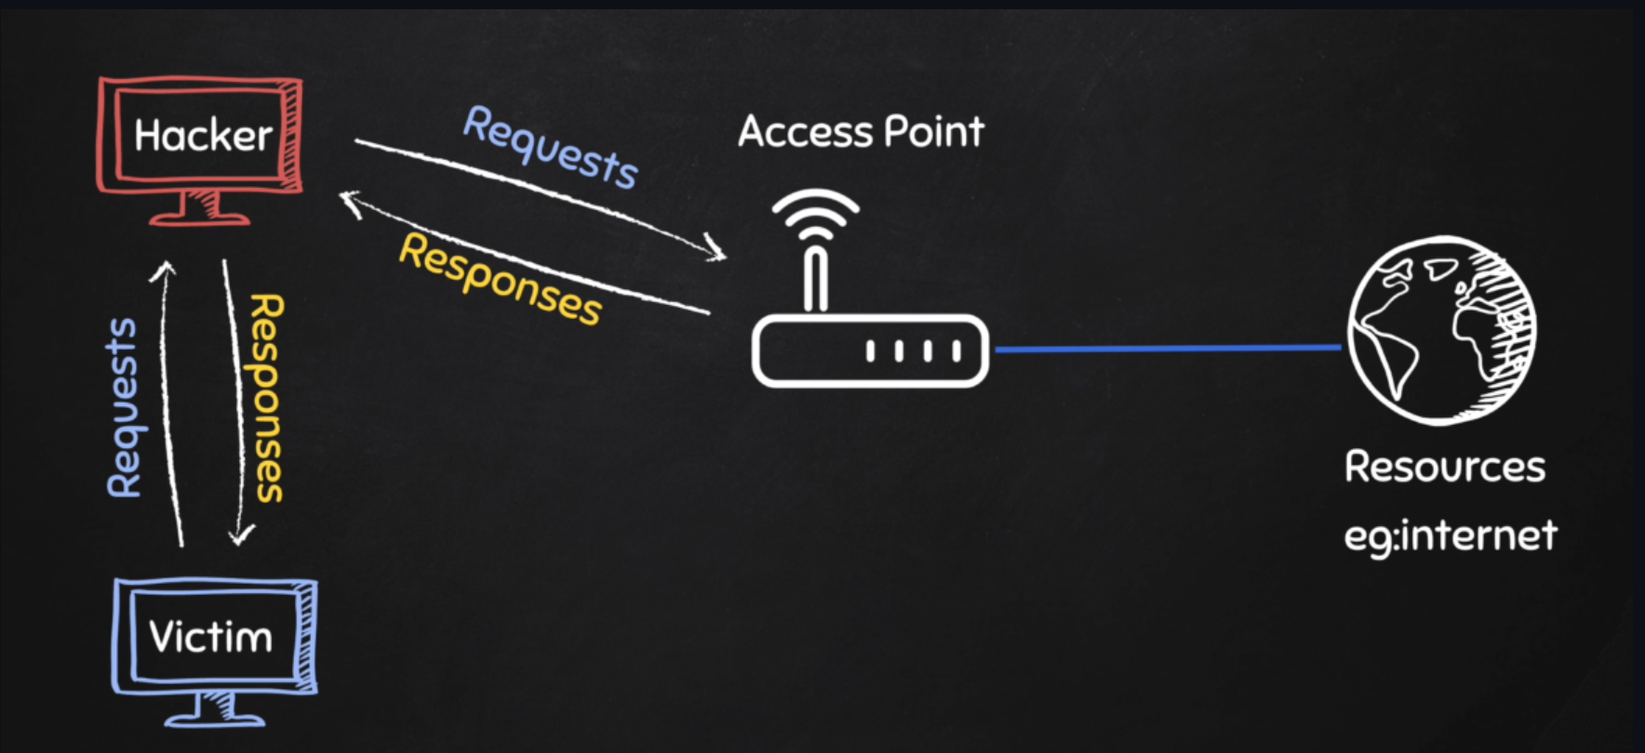
What is a Man-in-the-Middle Attack?
Attacker secretly intercepts communication between two devices
Uses ARP spoofing to impersonate the gateway
Victim unknowingly sends data through the attacker

Slide 3
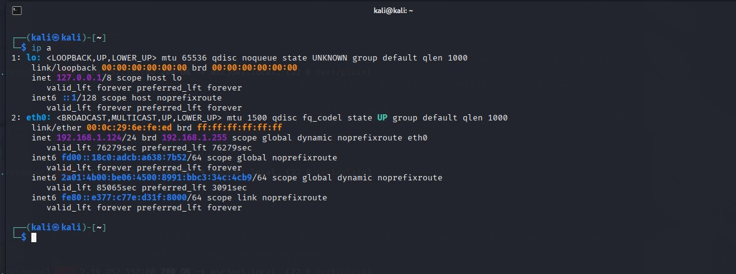
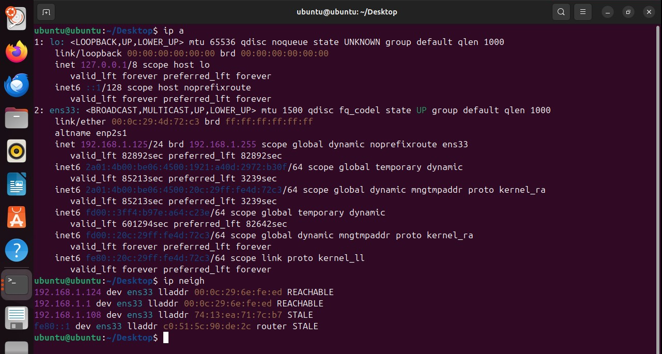
Attacker: Kali (192.168.1.124)
Victim: ubuntu (192.168.1.125)
Web Server: Windows (192.168.1.108)
Tool: Bettercap
The ubuntu machine 'thinks' the router MAC address is the same as the Kali since the ARP table is spoofed

Slide 4
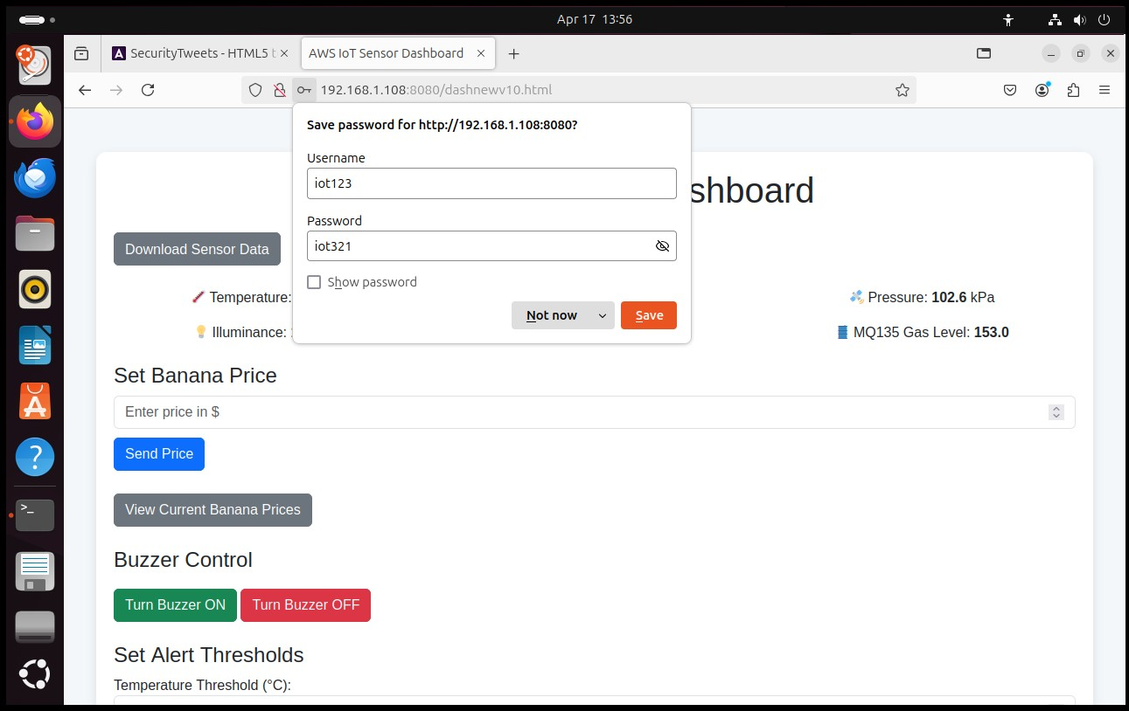
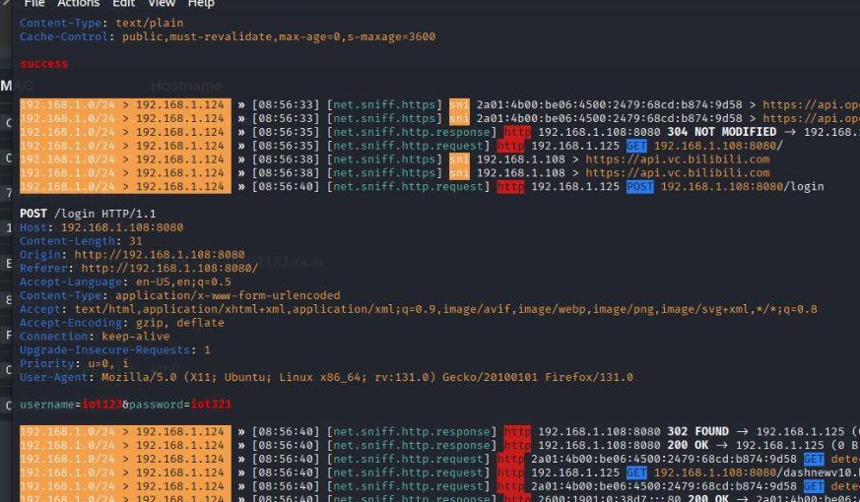
Bettercap Intercepts HTTP Login
Ubuntu try to login the IoT dashboard
Attacker sees full login request
Username and password seen in the CLI

Slide 5
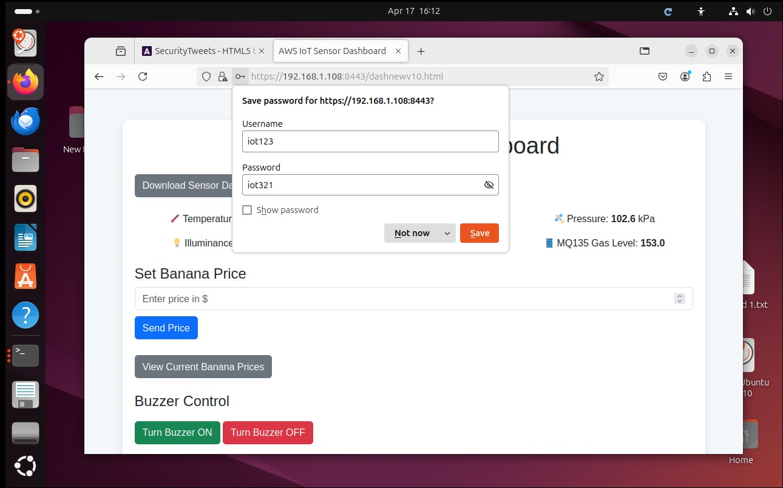
IoT Dashboard Secured with HTTPS
Self-signed certificate applied
Access now over HTTPS (port 8443)

Slide 6
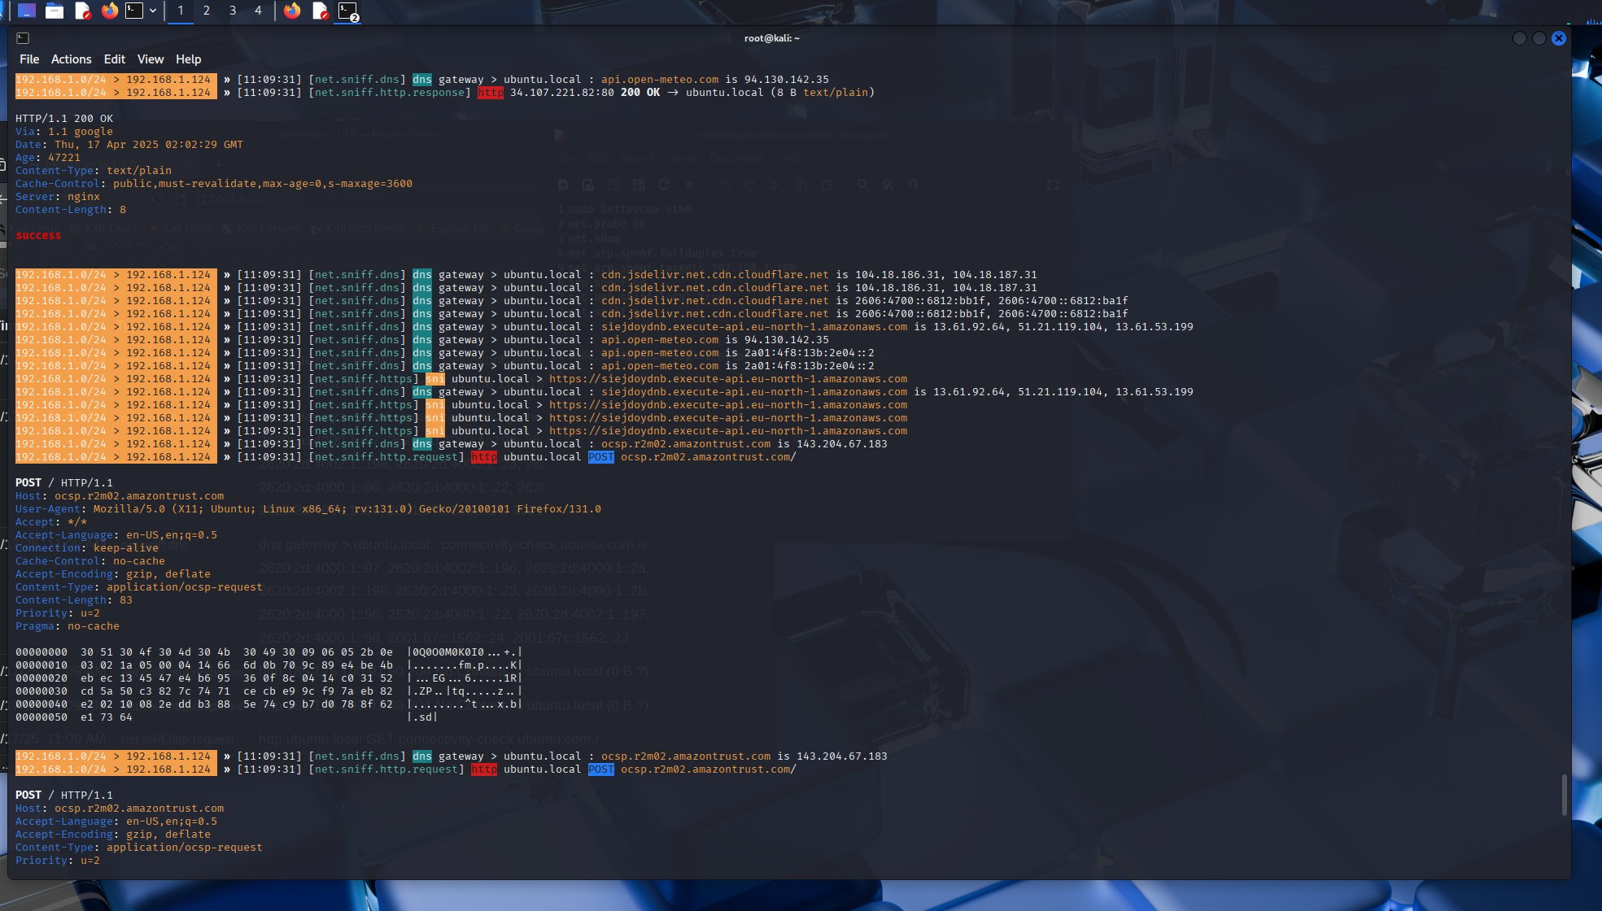
HTTPS Blocks Credential Theft
Traffic is now encrypted
Bettercap can no longer read login data

